Slide 1
Revised Short-Term Rental Ordinance Changes

Slide 2
Agenda
Differences between the current ordinance and the new ordinance
Short-term rental insurance coverage requirement
Exterior signage requirement
Changes in the fine schedule
Local representative change for on-site property managers
Fire Inspections
Inspection Scheduling
Questions and Answers
STR Ordinance Changes | Finance | 10/27/2022

Slide 3
Current and New STR Regulations for 2023
Current
$150 registration fee, or $10 or $5 for property managers.
Self-compliance affidavit
Local Representative
New
$260 registration fee, or $50 for 24/7 on-site property managers, who operate the on-site front desk.
Self-compliance affidavit and
Inspections (exempt properties in a building with 24/7 on-site management available at all times)
Local Representative
STR Ordinance Changes | Finance | 10/27/2022

Slide 4
Current and New STR Regulations for 2023
(2)
Current
Interior signage
Fines: 1st, $500
2nd- $1,500
3rd- $2,500
4th- Revoked for two year for short-term renting
New
Interior and Exterior signage
Fines: 1st- $1,500
2nd- $2,650
3rd- Suspended for three year for short-term renting
Homeowners insurance coverage for short-term renting.
STR Ordinance Changes | Finance | 10/27/2022

Slide 5
Short-Term Rental Insurance Requirement
$1,000,000 minimum liability coverage for short-term rental activity in the form of:
Homeowners insurance policy (must cover STR activities).
Commercial liability insurance.
Or an endorsement to a homeowner’s policy for coverage of STR activities.
Policy must state it covers short-term renting (declarations page/ stating coverage of short-term renting or commercial activity).
Insurance provided by online marketplace facilitators, such as Airbnb and VRBO, do not qualify.
STR Ordinance Changes | Finance | 10/27/2022

Slide 6
Short-Term Rental Insurance (2)
Upload during renewal process, or when applying for a new registration.
Please contact your provider on obtaining proper documentation.
Example Insurance Notice:
STR Ordinance Changes | Finance | 10/27/2022

Slide 7
Exterior Signage
Must be visible by passerby.
Will have the following information:
Identifying that this property is a short-term rental
Local representative’s contact information.
Town of Vail’s Short-Term Rental Complaint Hotline Phone Number.
Available on the license account under the section “Licenses.”
Properties located in a building with 24/7 on-site management available at all times are exempt.
STR Ordinance Changes | Finance | 10/27/2022

Slide 8
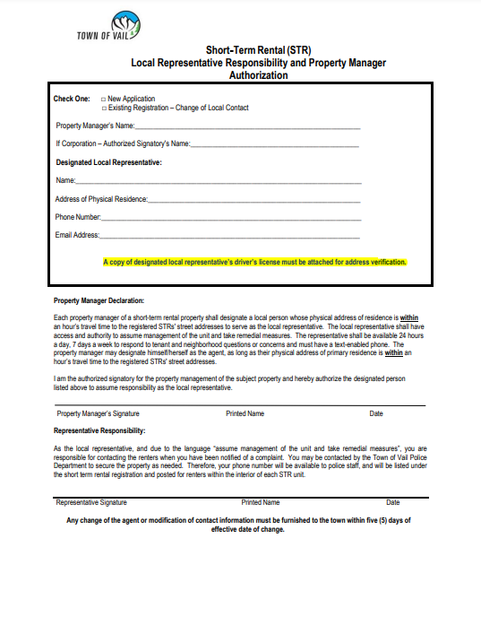
Local Representative Change
Property managers that provide 24/7 on-site management are no longer required to provide a local representative for licensing purposes.
All others still must have a local representative on file.
STR Ordinance Changes | Finance | 10/27/2022

Slide 9
Fire Department Inspections
Required Every Three Years (once ever three years) - properties in a building with 24/7 on-site management available at all times are exempt.
Each owner or property manager will need to upload approval document online.
Inspection approval is needed before completing a new license application.
Current registrations will have the task available for the first three years until uploaded and accepted.
Inspection check list available online at: vailgov.com/government/departments/finance/short-term-rentals
STR Ordinance Changes | Finance | 10/27/2022

Slide 10
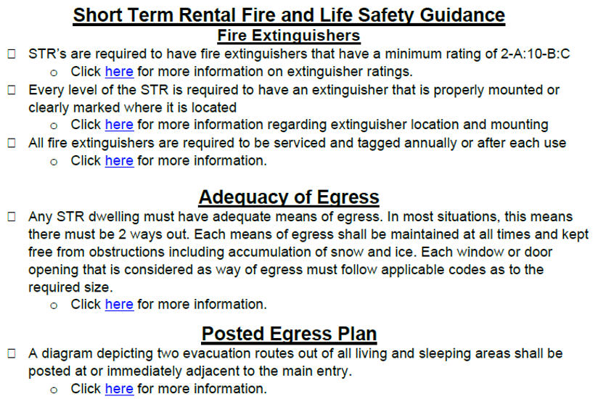
Fire Department Inspection Checklist (1)
STR Ordinance Changes | Finance | 10/27/2022

Slide 11
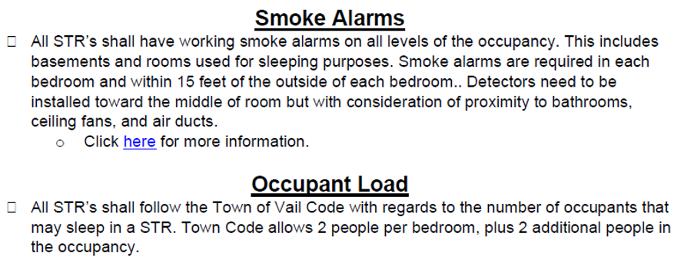
Fire Department Inspection Checklist (2)
STR Ordinance Changes | Finance | 10/27/2022

Slide 12
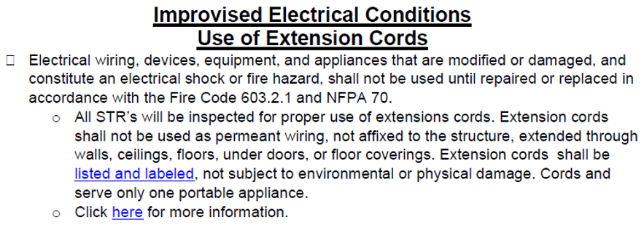
Fire Department Inspection Checklist (3)
STR Ordinance Changes | Finance | 10/27/2022

Slide 13
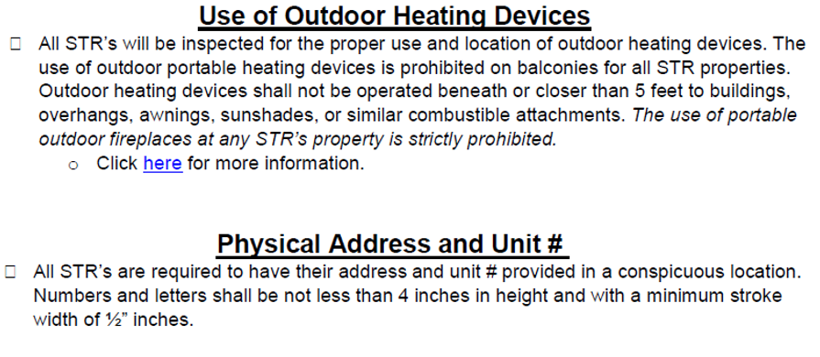
Fire Department Inspection Checklist (4)
STR Ordinance Changes | Finance | 10/27/2022

Slide 14
Fire Department Inspection Sign Up
How to schedule a fire inspection.
Complete Community Connect Property Information
Schedule appointment on Acuity. (this will be available on January 1st, 2023.)
STR Ordinance Changes | Finance | 10/27/2022

Slide 15
End
Questions?
STR Ordinance Changes | Finance | 10/27/2022

